Slide 1
Chapter 4: Fermentation

Slide 2
Fermentation
It is a chemical process by which complex organic molecules such as glucose are broken down into simpler substances by the enzymatic action of bacteria, yeasts or other microorganisms. It can be carried out in 2 ways:
Aerobic fermentation
Anaerobic fermentation

Slide 3
Conditions favourable for fermentation
Temperature
Aeration
pH conditions
Concentration
Presence of other substances
Absence of preservatives

Slide 4
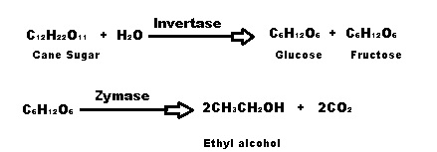
Production of some commercially important compounds
Ethyl Alcohol (from molasses)

Slide 5
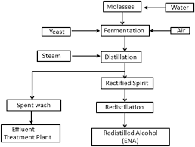
Process

Slide 6
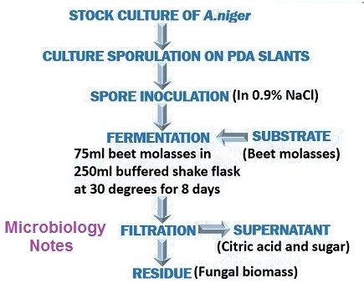
Citric Acid (from aspergillus niger)

Slide 7
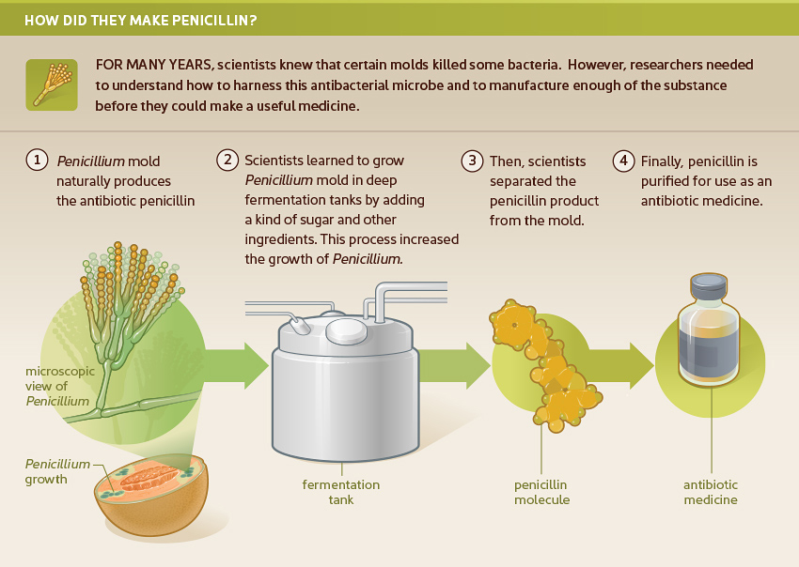
Antibiotics
Penicillin

Slide 8
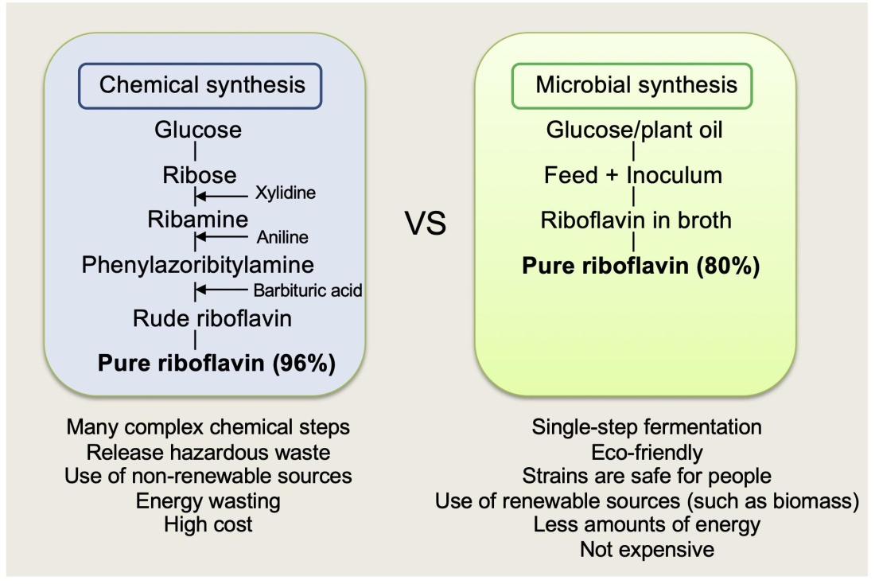
Vitamins
Vitamin B₂ (Riboflavin)

Slide 9
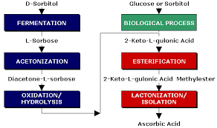
Vitamin C

Slide 10
Thank You

